Slide 1
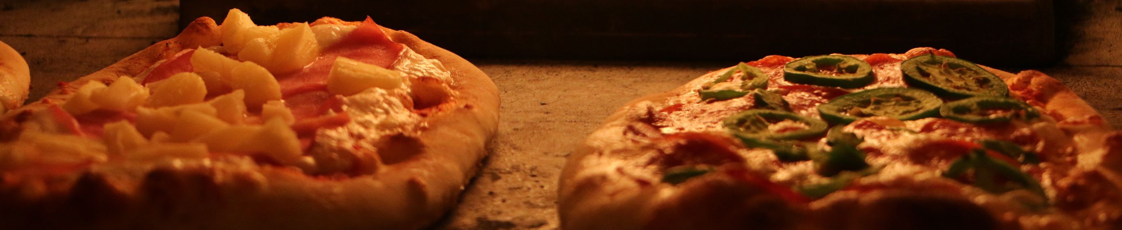
SQL PROJECT
ON
PIZZAHUT SALES

Slide 2

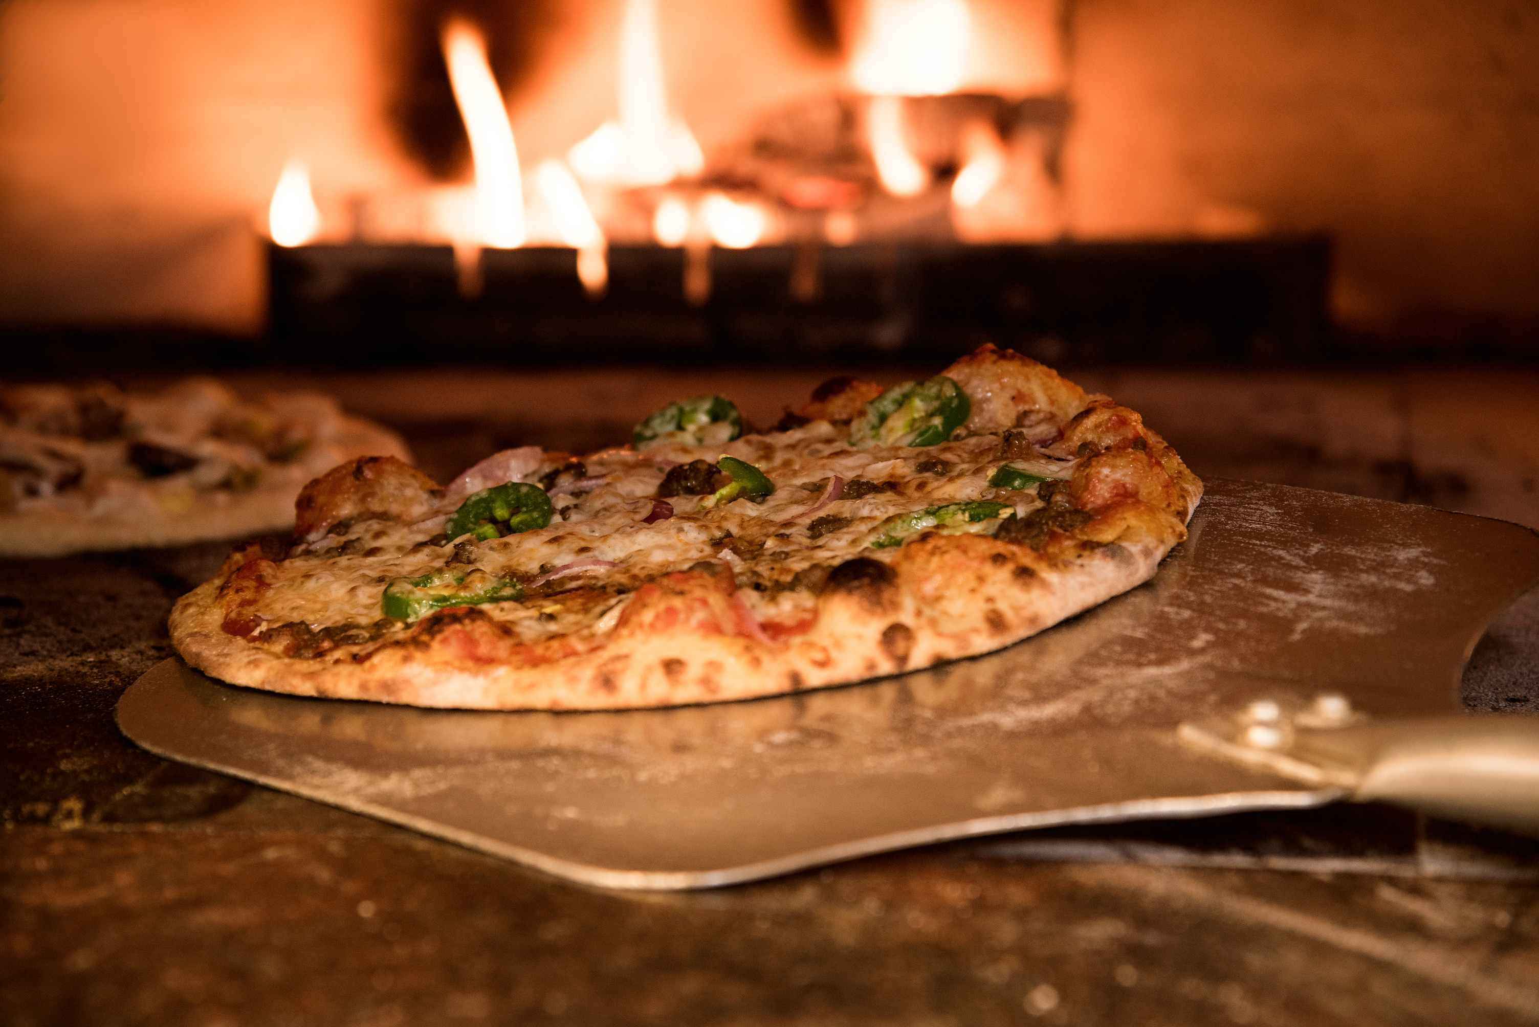
ABOUT ME
Hello , my name is riya sengar and in this project i have utilised sql query to solve questions that was related to pizza sales.

Slide 3
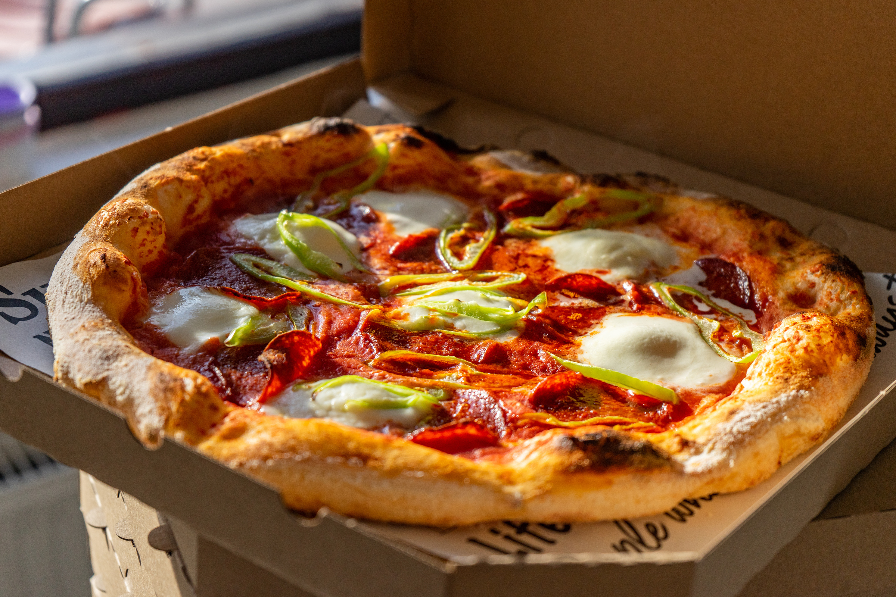
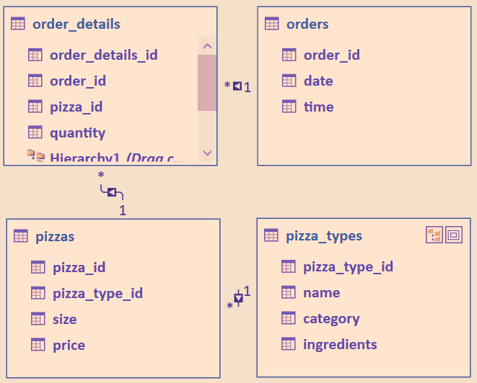
SCHEMA

Slide 4
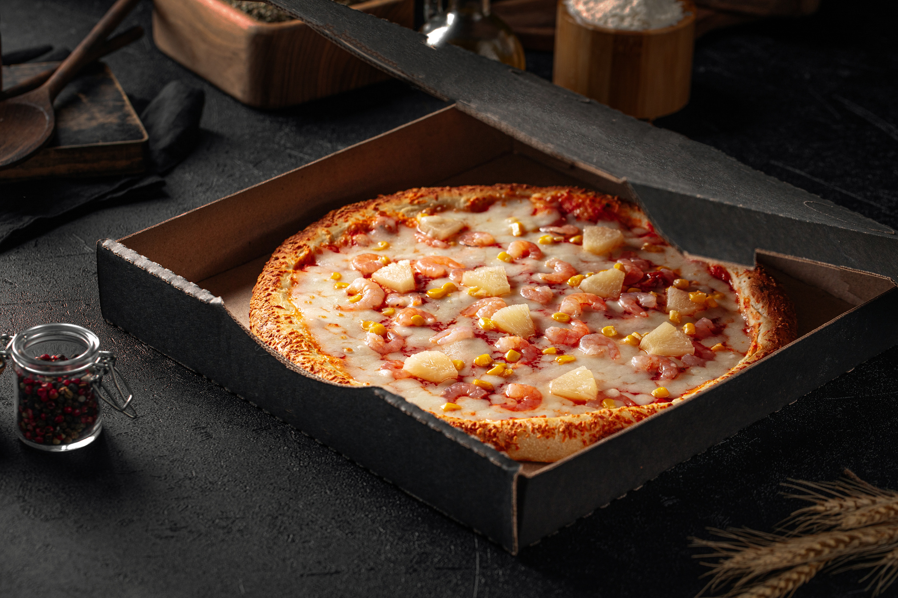
QUESTIONS
Basic:
Retrieve the total number of orders placed.
Calculate the total revenue generated from pizza sales.
Identify the highest-priced pizza.
Identify the most common pizza size ordered.
List the top 5 most ordered pizza types along with their quantities.
Intermediate:
Join the necessary tables to find the total quantity of each pizza category ordered.
Determine the distribution of orders by hour of the day.
Join relevant tables to find the category-wise distribution of pizzas.
Group the orders by date and calculate the average number of pizzas ordered per day.
Determine the top 3 most ordered pizza types based on revenue.
Advanced:
Calculate the percentage contribution of each pizza type to total revenue.
Analyze the cumulative revenue generated over time.
Determine the top 3 most ordered pizza types based on revenue for each pizza category.

Slide 5

HOW WE MAKE DELICIOUS FOOD
We have a lot of talented professional chefs to explore all ingredients for delicious food.

Slide 6
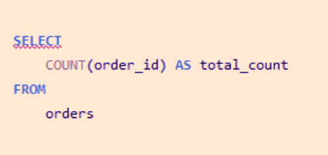
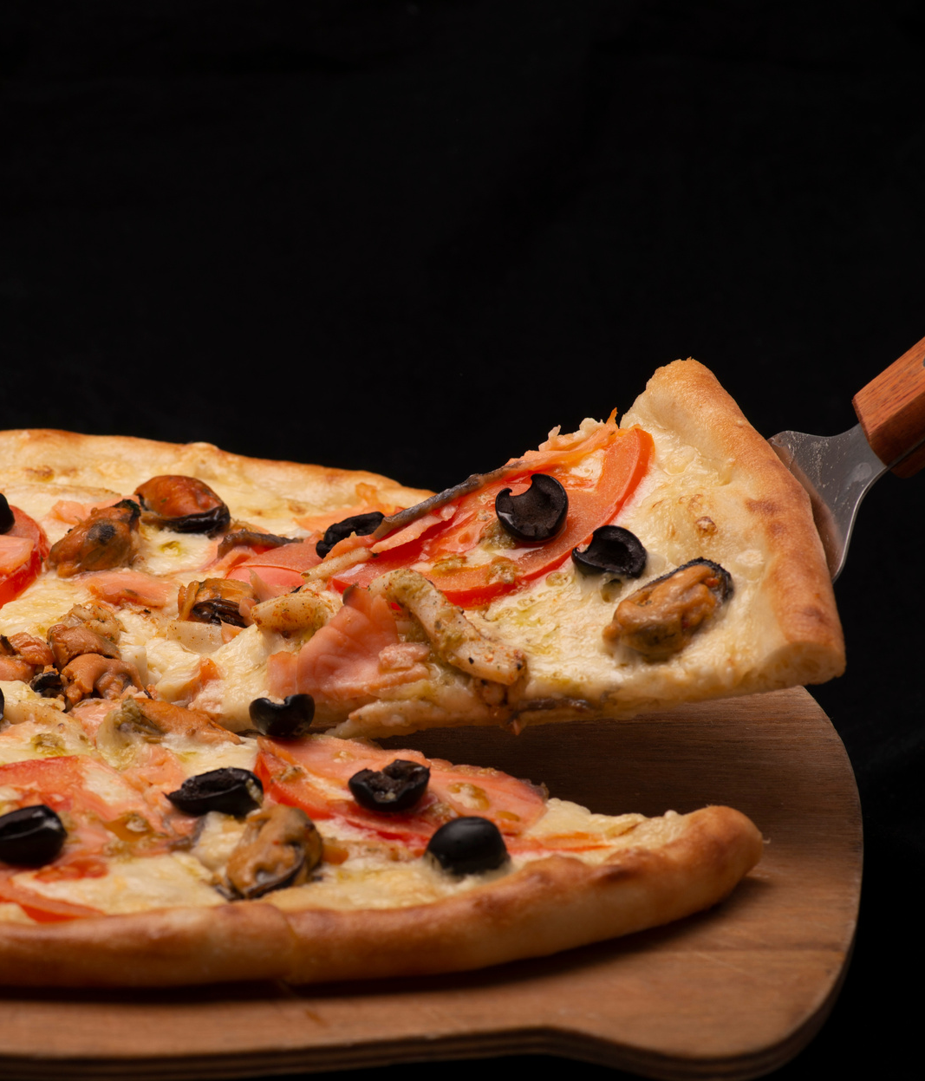
Retrieve the total number of orders placed.

Slide 7
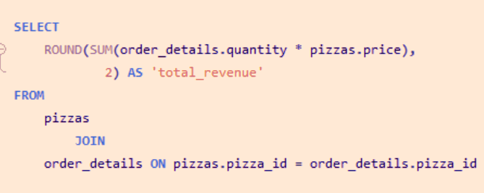
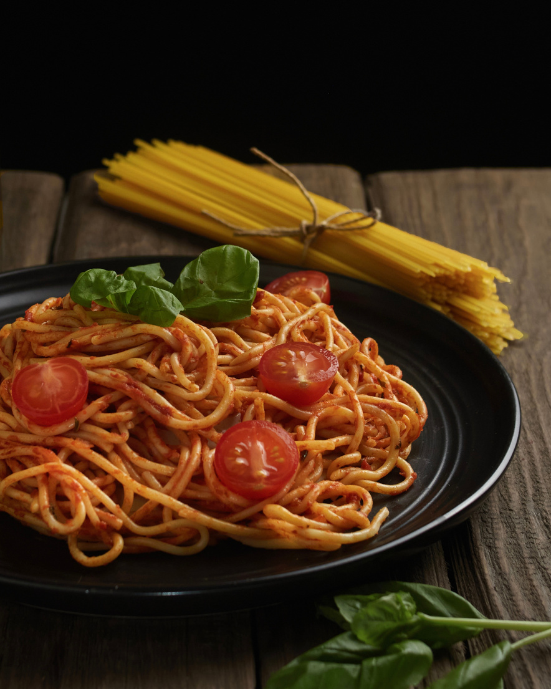
Calculate the total revenue generated from pizza sales.

Slide 8
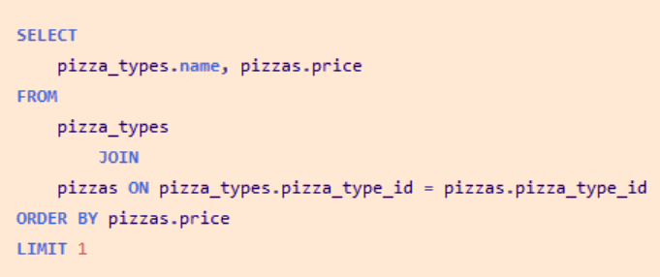
Identify the highest-priced pizza.

Slide 9
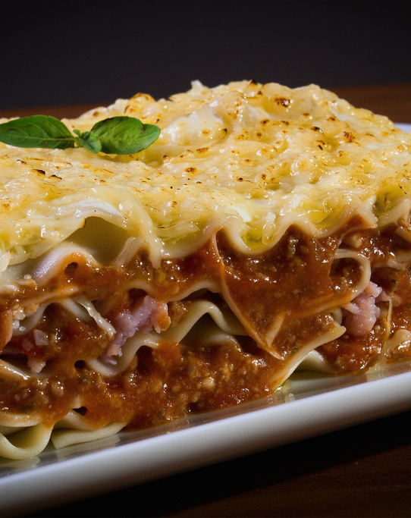
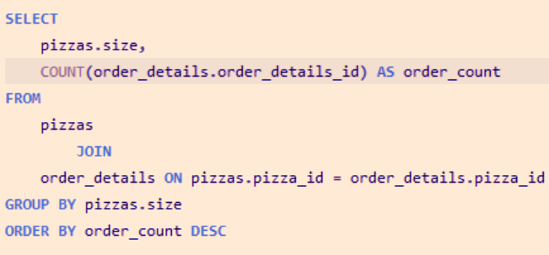
Identify the most common pizza size ordered.

Slide 10
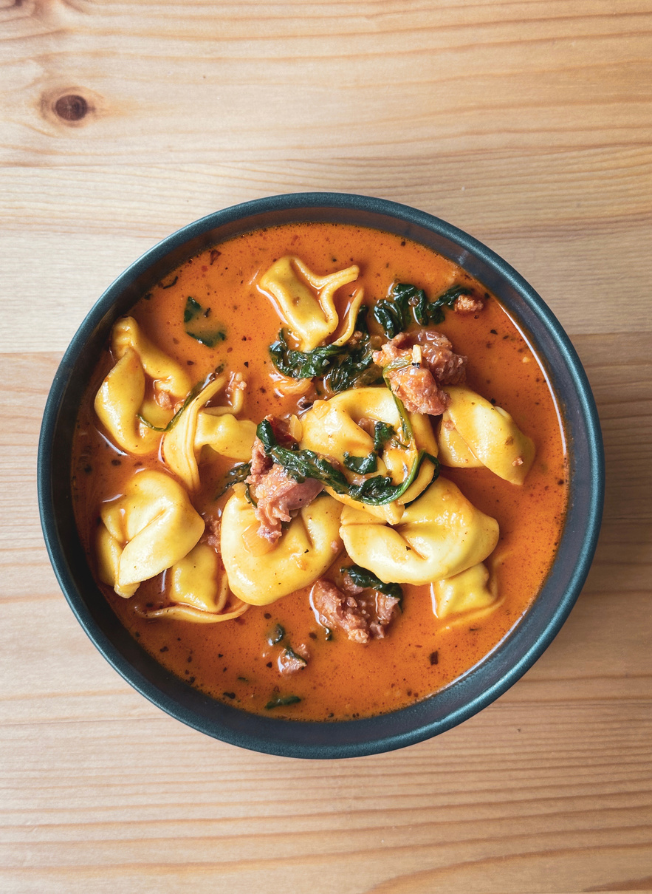
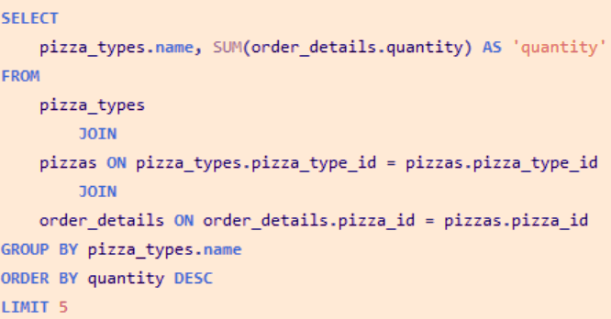
List the top 5 most ordered pizza types along with their quantities.

Slide 11
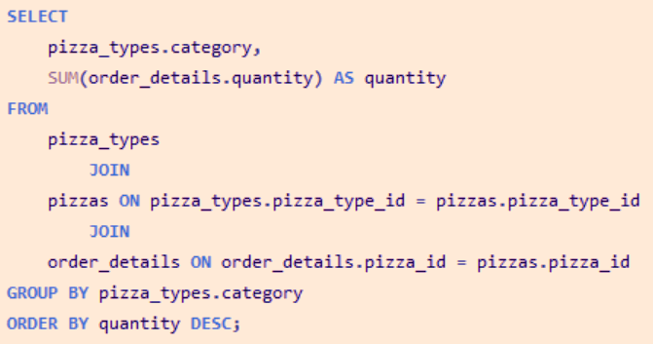
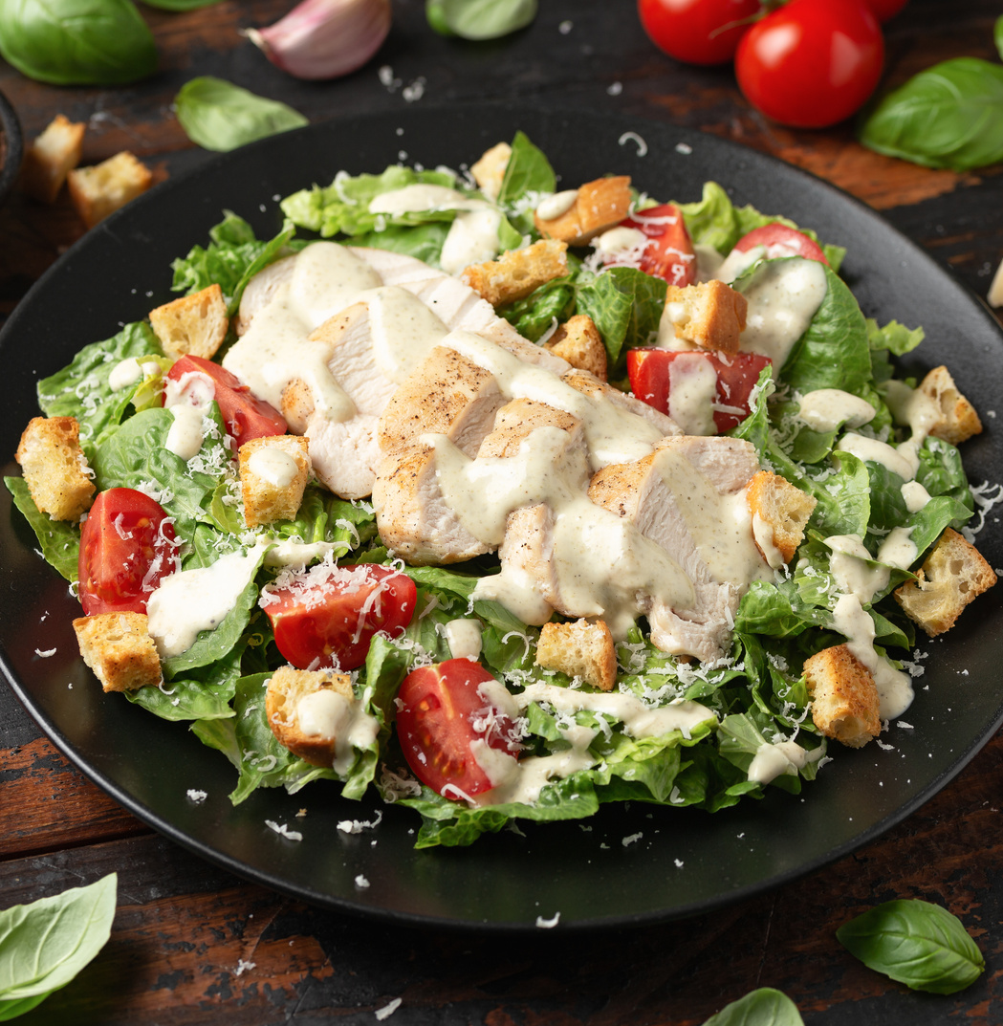
Join the necessary tables to find the total quantity of each pizza category ordered.

Slide 12
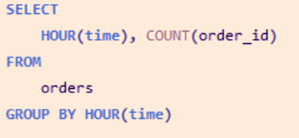
Determine the distribution of orders by hour of the day.

Slide 13
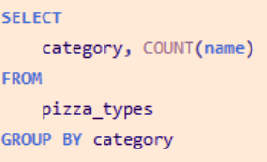
Join relevant tables to find the category-wise distribution of pizzas.

Slide 14
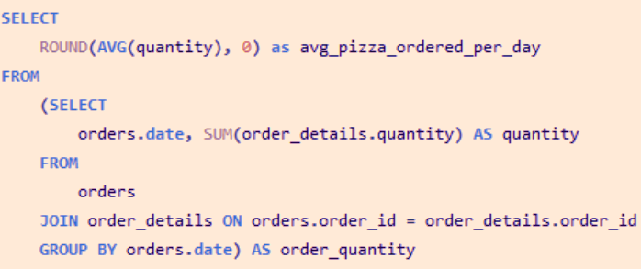
Group the orders by date and calculate the average number of pizzas ordered per day.

Slide 15
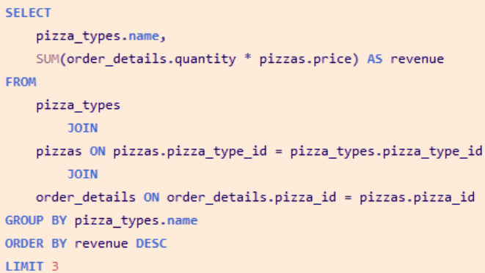
Determine the top 3 most ordered pizza types based on revenue.

Slide 16
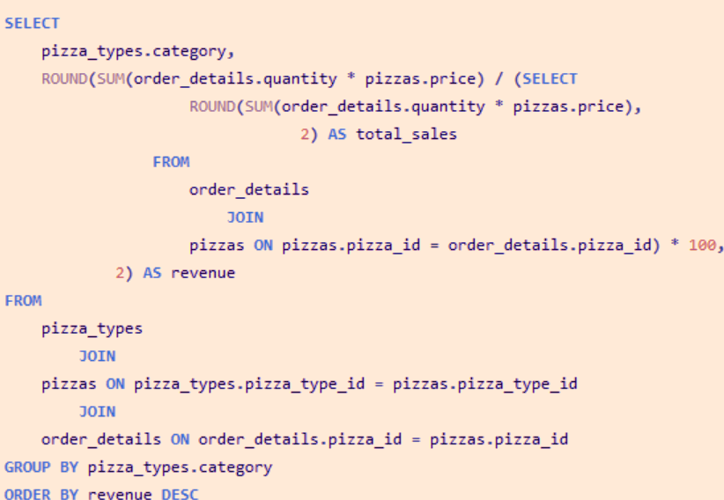
Calculate the percentage contribution of each pizza type to total revenue.

Slide 17
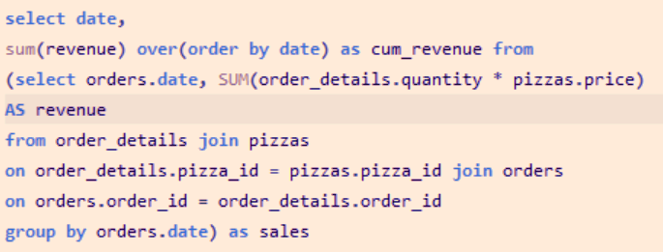
Analyze the cumulative revenue generated over time.

Slide 18
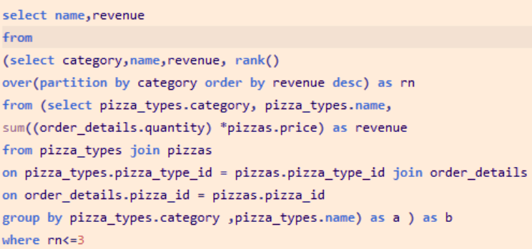
Determine the top 3 most ordered pizza types based on revenue for each pizza category

Slide 19
THANK YOU

